Slide 1
Chapter Three
Simplification & minimization
of
Boolean functions
Under graduate (2016)
Girma Adam (M.Tech)
3.<number>

Slide 2
Cont’d..
Topics discussed in this section:
Introduction
Karnaugh map representation of logical functions
Simplification of logical functions using K-maps.
Minimization of Boolean functions specified in
( minterms/ Maxterms or truth table)
Don't-care Combinations
EX-OR and EX-NOR
The tabulation method of minimization.
3.<number>

Slide 3
Introduction
A K-map (Karnaugh Maps ):- is a systematic methods for
simplifying and manipulating Boolean
expression.
:- is a collection of squares
  Each square represents a minterm and Maxterm
  The collection of squares is a graphical representation of a Boolean function
  Adjacent squares differ in the value of one variable
  Alternative algebraic expressions for the same function are derived by recognizing patterns of squares
3.<number>

Slide 4
Cont’d..
The K-map can be viewed as
  A reorganized version of the truth table
  A topologically-warped Venn diagram as used to visualize sets in algebra of sets.
K-map Provide a means for:
  Finding optimum or near optimum for functions with small
  numbers of variables
    1. SOP and POS standard forms, and
    2. two-level AND/OR and OR/AND circuit implementations
3.<number>

Slide 5
Cont’d..
  Visualizing concepts related to manipulating Boolean expressions
  Demonstrating concepts used by computer-aided design
  programs to simplify large circuits
3.<number>

Slide 6
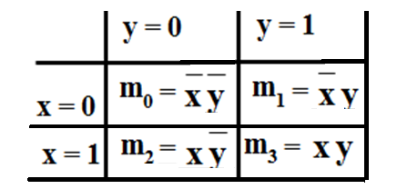
K- map representation of logical functions
Two Variable Maps
  Note that minterm m0 and
  minterm m1 are “adjacent”
  and differ in the value of the
  variable y
  Similarly, minterm m0 and
  minterm m2 differ in the x variable.
  Also, m1 and m3 differ in the x variable as well.
  Finally, m2 and m3 differ in the value of the variable y
3.<number>

Slide 7
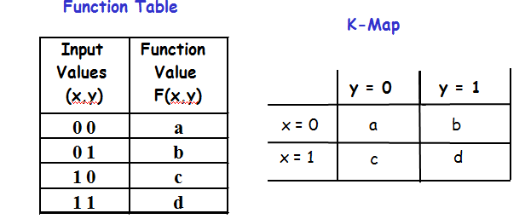
K-Map and Truth Tables
The K-Map is just a different form of the truth table.
Example – Two variable function:
  We choose a,b,c and d from the set {0,1} to implement a particular function, F(x,y).
3.<number>

Slide 8
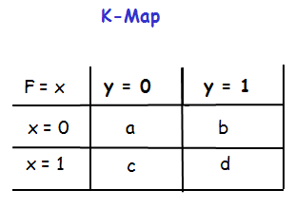

Cont,d..
Example: F(x,y) = x
For function F(x,y), the two adjacent cells containing 1’s can be combined using the Minimization Theorem:
3.<number>

Slide 9
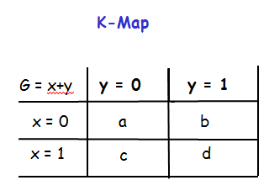

Cont’d..
2. Example: G(x,y) = x + y
For G(x,y), two pairs of adjacent cells containing 1’s can be combined using the Minimization Theorem:
3.<number>

Slide 10
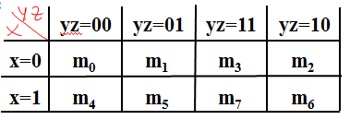
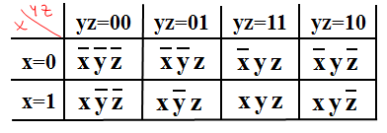
Cont’d..
A three-variable K-map:
Where each minterm corresponds to the product terms:
Note that if the binary value for an index differs in one bit position, the minterms are adjacent on the K-Map
3.<number>

Slide 11
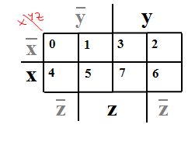
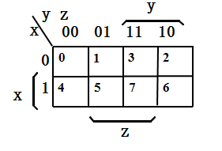
Cont,d..
Alternative Map Labeling
3.<number>

Slide 12
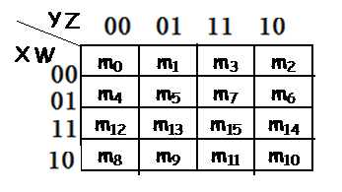
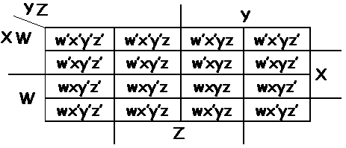
Cont,d..
Four variable k-map
Where each minterm corresponds to the product terms:
3.<number>

Slide 13
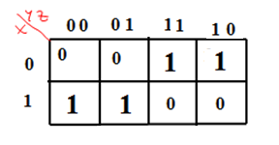
Representation of Standard Sop form on K-map
A logical equation in standard SOP form can be represented on a K-map by simply entering 1’s in the cells of the k-map corresponding to each minterm present in the equation.
Example 1.Represent the following standard SOP form by using
K-map ?
F = x’yz + x’yz’ + xy’z’ + xy’z
Solution
3.<number>

Slide 14
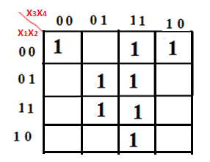
Cont’d...
Example2. Write the logical equation in the standard SOP
form from K-map ?
Solution
Y = X’1X’2X’3X’4 + X’1X’2X3X’4 +X’1X’2X3X4 + X’1X2X’3X4 + X’1X2X3X4 +
X1X’2X3X4 + X1X2X’3X4 + X1X2X3X4
= Σ m(0,2,3,5,7,11,13,15)
3.<number>

Slide 15
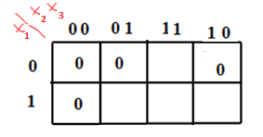
Representation of Standard POS form on k-map
A logical equation in standard POS form can be represented on a K-map by simply entering 0’s in the cells of the k-map corresponding to each maxterm present in the equation.
Example 1. Represent the following standard POS form by using
K-map ?
Y = (x1 + x2 + x3) (x1 + x2 + x’3) (x1 + x’2 + x3) (x’1 + x2 + x3)
Solution
3.<number>

Slide 16
Simplification of logical functions using K-maps.
Simplification of logical function with k-map is based on the principle of combining terms in adjacent cells.
The simplification of logical function is achieved by grouping adjacent 1,s or 0’s in groups of 2^{i} , where i= 1,2,……,n, n= is the number of input variables.
Grouping two adjacent ones
If there are adjacent ones on the map, these can be grouped together and the resulting term will have one less literal than the original two terms.
3.<number>

Slide 17
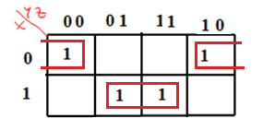
Cont’d...
Example1. Simplify the given K-map ?
Solution
The standard SOP form of equation can be
Y = x’y’z’ + x’yz’ + xy’z + xyz , if we combine the ones in adjacent cells (0,2) and (5,7) then the equation will be
Y = X’Z’ +XZ
3.<number>

Slide 18
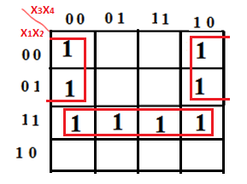
Cont’d...
2. Grouping four adjacent ones
Four cells form a group of four adjacent ones if two of the literals associated with the minterms/maxterms are not same and the other literals are same.
Example1. Simplify the given K-map ?
3.<number>

Slide 19
Cont’d..
Solution
The standard SOP form of equation can be
Y = m0 + m4 + m12 + m13 + m14 + m15 + m6 + m2
= (m0 + m4 + m6 + m2) +(m12 + m13 + m14 + m15 ), there are two groups of four adjacent ones on cell (0,4,2,6) and (12,14,15,13).
Y = X1 X2 + X’1 X’4
3.<number>

Slide 20
Cont’d..
3. Grouping eight adjacent ones
Eight cells form a group of eight adjacent ones if three of the literals associated with minterms/maxterms are not same and the other literals are same
Summary
On a 3-variable K-Map:
  One square represents a minterm with three variables
  Two adjacent squares represent a product term with two variables
3.<number>

Slide 21
Cont’d..
  Four “adjacent” terms represent a product term with one variable
  Eight “adjacent” terms is the function of all ones (no variables) = 1.
4. Grouping 2,4,8 adjacent zeros
Similar to the above procedure instead of making the groups of ones, we can also make groups of 2,4,8 zeros.
3.<number>

Slide 22
Summary
Complete K-map Simplification Process
  Construct the K-map and place 1’s and 0’s in the squares according to the SOP expression or truth table
  Find the largest grouping of 1’s that are not already all in a group; if there is more than one possibility. Choose a grouping that minimizes the total number of groups.
  Repeats step 2 until only isolated 1’s remain
  Form single groups of the remaining isolated 1’s.
  find the product term that corresponds to each groups
  OR together all the product terms
3.<number>

Slide 23
Minimization of Boolean functions specified in
minterms/ Maxterms or truth table
We have seen the advantages of simplifying a logical expression . If the expression is simplified to a stage beyond which it can be further simplified. Such expression is referred to as minimized expression.
Minimization of SOP form
For minimizing a given expression in SOP form using k-map can be used the following algorithms
1. Identify the ones which can’t be combined with any other
ones and encircle them.
3.<number>

Slide 24
Cont’d..
2. Identify the ones which can be combined in groups of two in
only one way. encircle such groups of ones
3. Identify the ones which can be combined with three other
ones, to make a group of four adjacent ones, in only one
way. Encircle such groups of ones.
4. Identify the ones which can be combined with seven others
ones, to make a group of eight adjacent ones, in only one
way . Encircle such groups of ones.
3.<number>

Slide 25

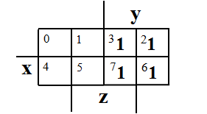
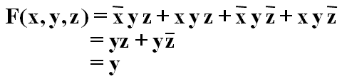
Cont’d..
Example 1:-
Applying the Minimization Theorem three times:
Thus the four terms that form a 2 × 2 square correspond to the term "y".
3.<number>

Slide 26
Cont’d..
yz
00 01 11 10
2.
X | Y | Z | F(X,Y,Z)
0 | 0 | 0 | 0
0 | 0 | 1 | 1
0 | 1 | 0 | 0
0 | 1 | 1 | 1
1 | 0 | 0 | 1
1 | 0 | 1 | 0
1 | 1 | 0 | 0
1 | 1 | 1 | 1
0 1 1 0
0
x
1
1 0 1 0
2x4 Karnaugh Map
3.<number>

Slide 27
Cont’d..
yz
00 01 11 10
0 1 1 0
0
x
1
1 0 1 0
Circle all 1 entries that, taken together, form a subcube (i.e. rectangle).
Start with the largest subcubes, then proceed to smaller subcubes
Generally speaking, there will be more than one independent subcube,
each reflecting a different prime implicant.
3.<number>

Slide 28
Cont’d..
yz
00 01 11 10
Each subcube (rectangle) corresponds to a prime implicant term.
Gathering all terms in SOP form,
f = xy’z’ + x’z + yz
0 1 1 0
0
x
1
1 0 1 0
3.<number>

Slide 29
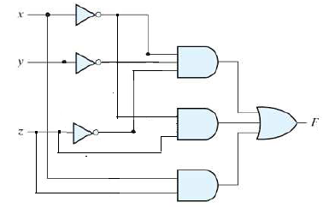
Cont’d..
The logic diagram of the Boolean function
3.<number>

Slide 30
Cont’d..
3.
yz
00 01 11 10
x’[yz + y’z + yz’ + y’z’]
= x’[(y+y’)z + (y+y’)z’]
= x’[z+z’]
= x’
x’y’z’+x’yz’+xy’z’+xyz’
= x’(y’+y)z’ +x(y’+y)z’
= (x’+x)(y’+y)z’
= z’
1 1 1 1
0
x
1
1 0 0 1
Collecting literals into a product gives:
x’ + z’
3.<number>

Slide 31
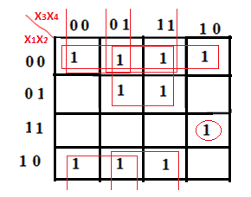
Cont’d..
4. Exercise
1. Minimize the four input variables logic function using k-map
f(x1, x2, x3, x4) = Σm(0,1,2,3,5,7,8,9,11,14)
Solution
f(x1, x2, x3, x4) = x1x2x3x’4 + x’2x’3 +x’2x4 + x’1x4 + x’1x’4
3.<number>

Slide 32
Cont,d..
2. Minimization of POS form
For minimizing a given expression in POS form using k-map can be used the same procedure as used for SOP form with ones replaced by zeros. In this, groups of zeros are formed rather than groups of ones.
Example 1:- Minimize the logic function of equation using k-map
f(x1, x2, x3, x4) =ΠM(4,6,10,12,13,15)
solution
3.<number>

Slide 33
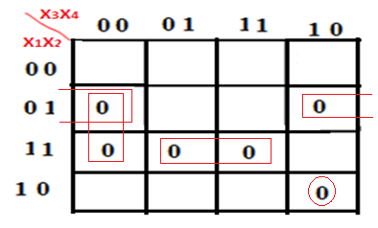
Cont’d..
We obtained the minimized expression
Y = (x’1 + x2 + x’3 + x4) (x’1 + x’2 + x3) (x1 + x’2 + x4) (x’1 + x’2 + x’4)
3.<number>

Slide 34
Don't-care Combinations
we enter 1’s and 0’s in the map corresponding to input variables
that make the function equal to 1 or 0 respectively.
This is not always true since there are cases in which certain
combination of input variables do not matter.
In such situations the designer has a flexibility and it is left to
him whether to assume a 0 or a 1 as output for each of these
combinations.
This condition is known as don’t care condition and can be
represented on k-map as a x-mark in the corresponding cell.
The x-mark in cell may be assumed to be 1 or 0 depending on
which one leads a simpler expression.
3.<number>

Slide 35
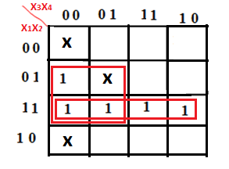
Cont’d..
The function can be specified in one of the following ways:-
1. In terms of minterm and don’t care condition
Example1:- f(x1, x2, x3, x4) =Σm(4,13,12,14,15) +d(0,5,8)
Solution
The k-map and the minimized expression are
f(x1, x2, x3, x4) = x2x’3 +x1x2
3.<number>

Slide 36
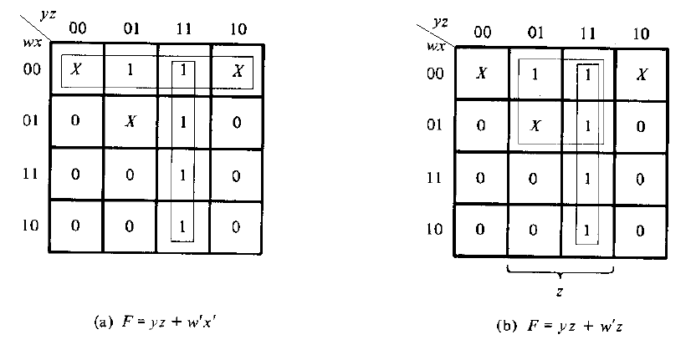
Cont’d..
Example 2:- f(w, x, y, z) =Σm(1,3,7,11,15) +d(0,2,5)
Solution
The k-map and the minimized expression are
3.<number>

Slide 37
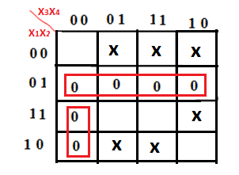
Cont’d..
2. In terms of maxterms and don’t –care conditions
Example:- f(x1, x2, x3, x4) =ΠM(4,5,6,7,8,12) d(1,2,3,9,11,14)
Solution
The k-map and the minimized expression are
f(x1, x2, x3, x4) = (x’1 +x3 +x4 )(x1 + x’2 )
3.<number>

Slide 38
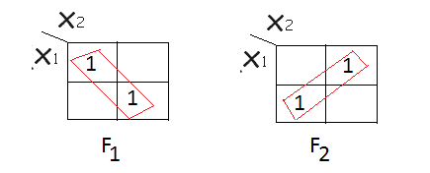
Ex-OR and Ex-NOR simplification k-map
In this case simplification can be considered
1. Diagonal adjacencies
2. Offset adjacencies
All the possible diagonals and offset adjacencies are marked in
the figure below and terms corresponding to each group of
adjacency involving Ex-OR or Ex-NOR operation are given below:-
1. For two variables
3.<number>

Slide 39

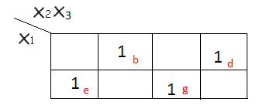
Cont’d..
Both F1 and F2 are diagonal , can be simplified
2. For three variables
- both b and e are diagonal
- both d and g are diagonal
- both b and g are diagonal
- both d and e are diagonal - both b and d are offset
- both e and g are offset
3.<number>

Slide 40
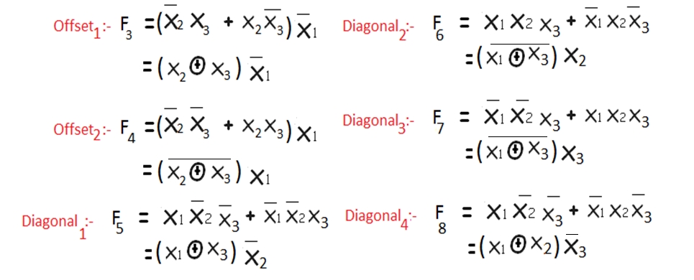
Cont’d…
Simplify the given K-map ?
3.<number>

Slide 41
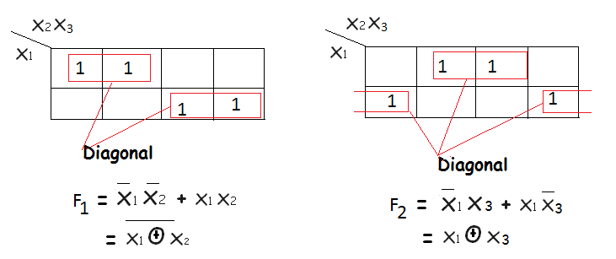
Cont’d…
Diagonal and offset adjacencies of groups of two ones
Example 1:-
3.<number>

Slide 42
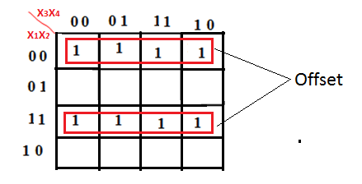

Cont’d…
Example 2:- Simplify the given K-map ?
3.<number>

